Slide 1
PROVIDER EDUCATION SERIES Presented by AzAHP and AHCCCS Health Plans
Session #4 AzAHP Form

Slide 2
AzAHP Form
AzAHP Form
Practitioner Data Form
PDF
Alliance Form
Enrollment Form
Required by all plans to assist in determining network need

Slide 3
General Guidelines
Read
Read through the document to prepare properly
Follow
Follow the instructions
Ask questions of any plan
Complete
Complete the form in its entirety
Leave no blank spaces
Use NA in any space that doesn’t apply
Ensure
Ensure your CAQH application and attestation is up to date
For more information, please see session #5 CAQH session
Submit
Submit the form with all applicable documents to all health plans you wish to obtain a contract or are currently contracted

Slide 4
Further Guidelines
Please use a supplemental sheet to include other Practitioners in your call group and hospital and ambulatory surgical centers privileges, (See page 11 of application)
Please use the supplemental sheet for additional offices. (See page 10 of application)
Provider Assessment of Cognitive and Physical Disabilities Accommodations must be completed—a separate Assessment for each location. (See pages 4 and 5)
One AzAHP form and the required documents are needed regardless of the number of plans you wish to obtain a contract or currently contracted

Slide 5
Required Attachments
Copy of Board Certification or CMEs in your specialty
Copy of W9
Copy of Certificates of Insurance information as appropriate
Commercial General Liability
Business Automobile Liability
Workers’ Compensation Liability
Professional Liability

Slide 6
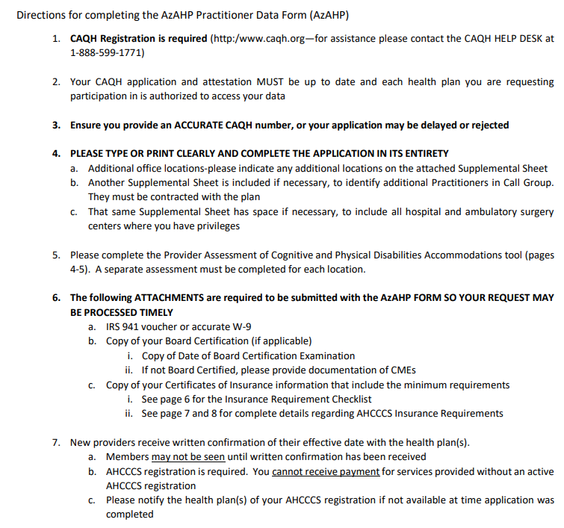
AzAHP Form
Instruction Page

Slide 7
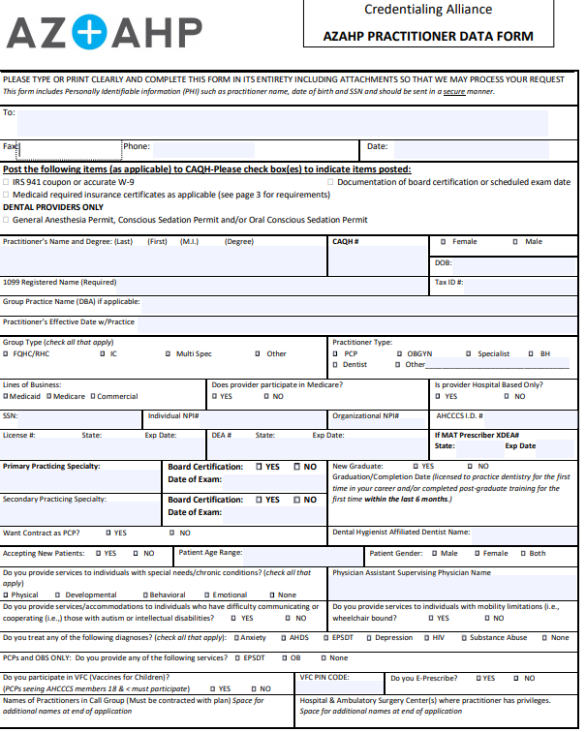
AzAHP Form
Enter CAQH #
Multiple providers in your practice and at the same location—just complete this section for the additional providers

Slide 8
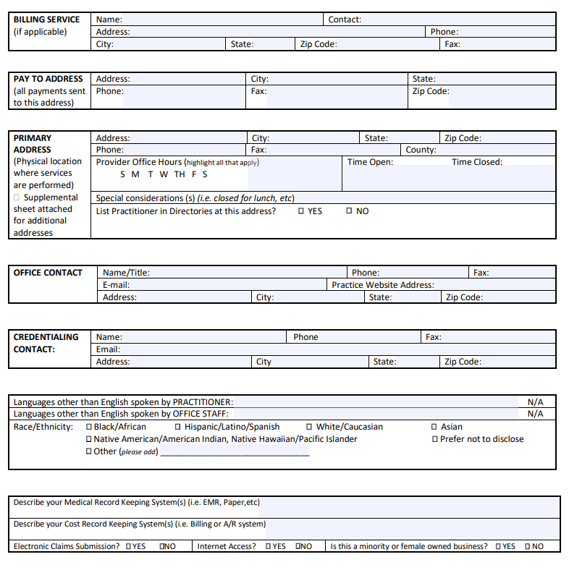
Addresses

Slide 9
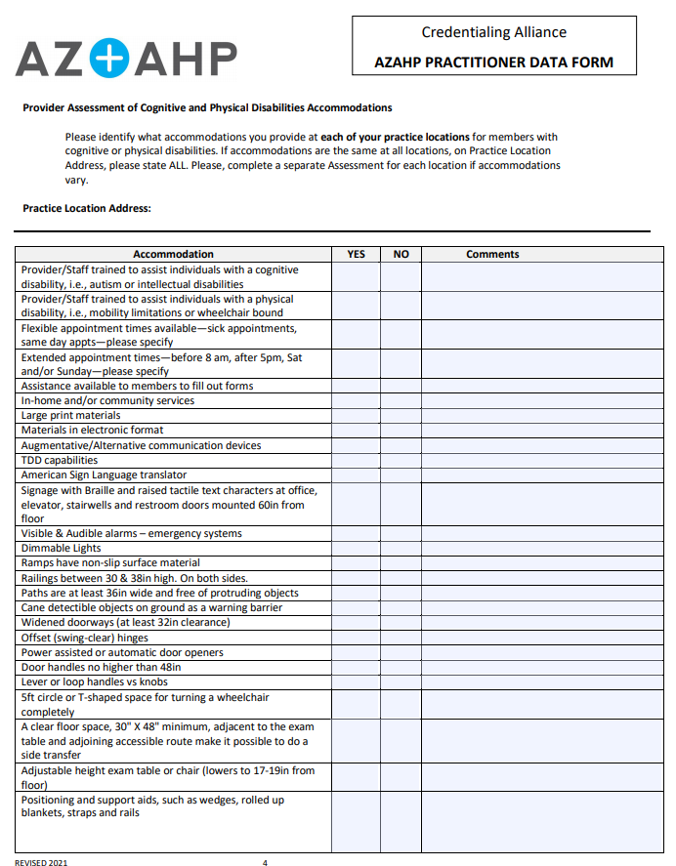
Provider Assessment of Cognitive and Physical Disability Accommodations
Assessment must be completed for each location

Slide 10
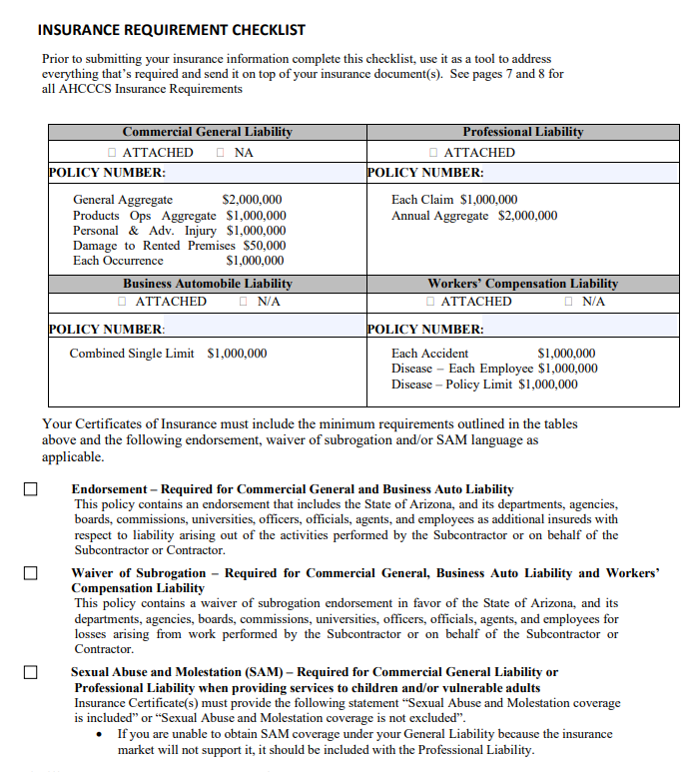
AHCCCS Insurance Requirements
Indicates where you MUST enter your policy number
Use checklist to ensure all insurance requirements are addressed

Slide 11
AHCCCS Insurance Requirements
Additional information about any questions regarding insurance requirements can be found on pages 7 and 8
Talk with your Network Management contact at the health plans you are applying to with any questions regarding the insurance requirements

Slide 12
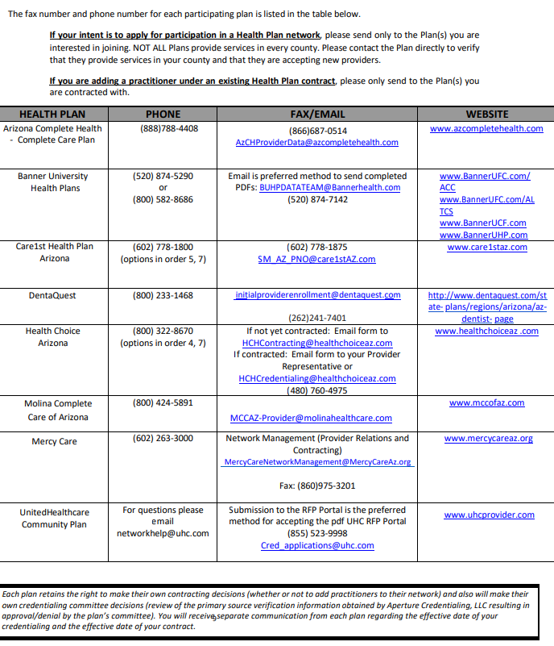
Health Plan Contact List

Slide 13
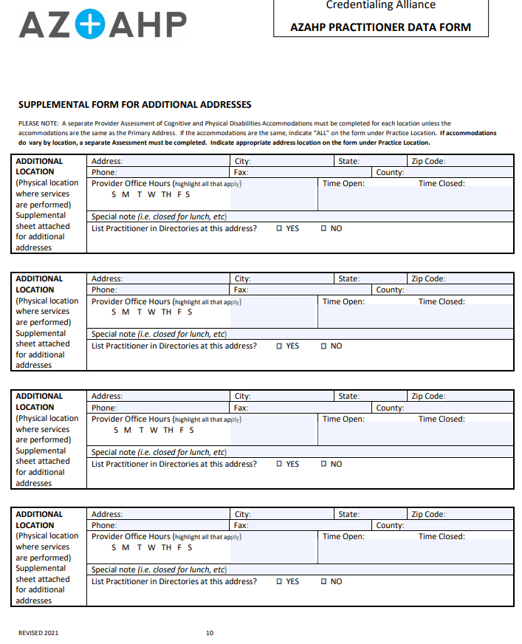
Additional Location
Room to include additional office locations - please use the Supplemental Form on page 10

Slide 14
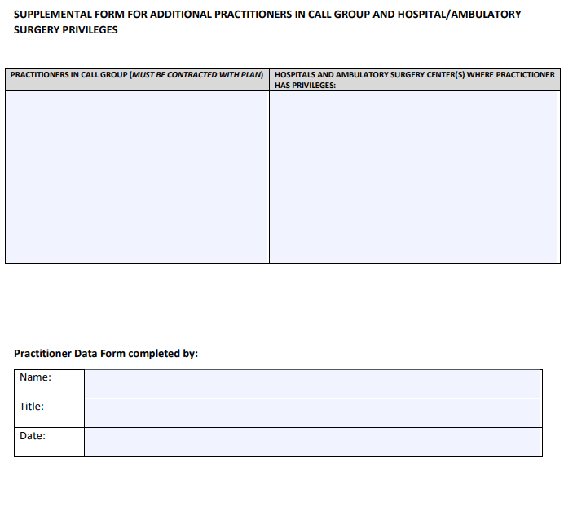
Practitioner Call Group and Privileges
Room to include all practitioners in call group and privileges in hospitals and ambulatory services

Slide 15
Final Notes
Health Plan contact list can be found on the last page of the AzAHP form(page 9)
Each Plan retains the right to make their own contracting decisions
Each Plan will make their own independent credentialing committee decisions
You will receive separate communication from each health plan regarding the effective date of your credentialing and effective date of your contract

Slide 16
Thank you for taking time to listen to Session # 4. If you have additional general questions, please go to www.azahp.org, click on AzAHP Credentialing Alliance and click on “Ask Pat”. Please note, Pat cannot answer specific questions regarding your credentialing status with any plan.

